Slide 1
3rd Management Committee and Working Group Meetings
Working Group Presentations
Albert Gatt
University of Malta
Working Group 1
INESC-ID, Lisbon - December, 11th 2020
Notes:
The year has been hard, but here we are gaining momentum and making efforts to move forward … BLABLABLA

Slide 2
WG1 - Overview
“Grounded multi-modal reasoning and generation”
Chair: Albert Gatt, University of Malta
Co-Chair: Mehul Bhatt, Örebro University, Sweden
Currently, around 21 members

Slide 3
Outline
Thematic focus of the WG
Activities to date
Future plans

Slide 4
WG Thematic Focus
Discussed during the meeting in Copenhagen (January 2020)
Explanation and transparency of multimodal models
Complementarity vs Redundancy
Relationship between Symbolic and Subsymbolic representations
The role of Commonsense and World Knowledge in multimodal models
Data sources
Situatedness
Notes:
Explanation and transparency of multimodal models
Complementarity vs Redundancy (i.e. the extent to which models are able to exploit information from more than one modality, rather than relying on just one and still apparently performing well in classification or generation tasks)
Relationship between Symbolic and Subsymbolic representations
The role of Commonsense and World Knowledge in multimodal models
Data sources (related to the point 2 above)
Situatedness

Slide 5
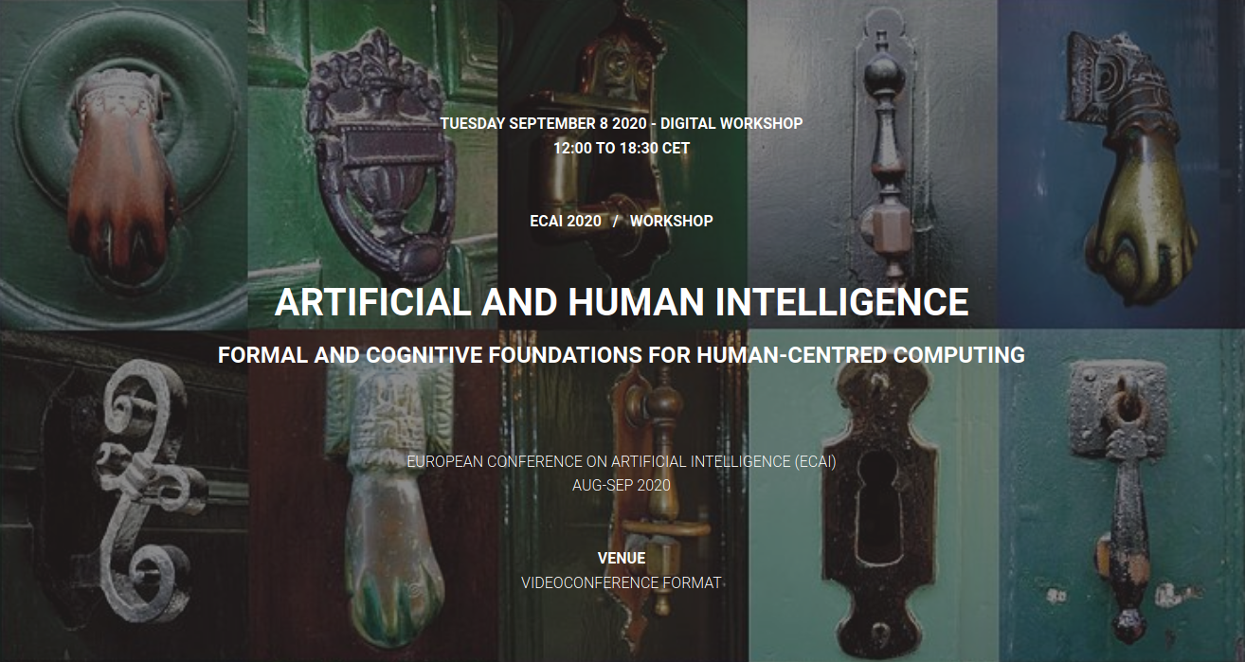
Initiatives by WG1 members
Round-table discussion on Multimodal Rhetoric and Visuo-auditory media.
Notes:
The round table was organised around the theme of Multimodal Rhetoric and Visuoauditory Media Studies: On the Role of Cognition and AI and chaired by Mehul Bhatt as a special session in the Artificial and Human Intelligence Workshop. It included contributions by Albert Gatt on grounding in Vision and Language models, as well as a general introduction to the Multi3Generation COST Action and the role of WG1.

Slide 6
Initiatives by WG1 members
Short-term scientific mission:
Prof Francois Portet (U. Grenoble) visited UM in October 2020.
Outcomes:
Intensive discussions with the UM NLP group on grounding beyond the visual modalities, leading to a review document/technical report (in progress).
Design of a M.Sc. thesis project on grounding and generation from video data. Now underway, jointly supervised by UM and Grenoble.

Slide 7
Initiatives by WG1 members
Ongoing collaboration between UM, Uni. Heidelberg and U. v. Amsterdam.
Focus: visual grounding of large-scale pretrained multimodal transformers.

Slide 8
Where do we go from here?
At the Copehagen meeting, two initiatives in particular were highlighted:
Review of the state of the art in multimodal grounding and reasoning.
Shared task
The above need to be discussed at the Lisbon WG meeting. The aim is to formulate a concrete program for a full WG meeting in early 2021.

Slide 9
Thank you!

